Slide 1
pycasso
Art and Coding in harmony
Allen Nguyen

Slide 2
What is art made of?
Colors in pleasing arrangement
Red, Yellow and Blue
Cyan, Magenta, Yellow, Black (CMYK)
Red, Green, and Blue (RGB)
Figure 1. RGB, CMYK and RYB can be mixed to produce different colors. (2016) Difference Between CMYK and RGB Colors. [JPEG file]. Retrieved from https://www.brainybeaver.com/difference-between-cmyk-and-rgb-colors/

Slide 3
The pixel: A messenger of color
Pixels hold six values
(x,y,r,g,b,a)
Pixels made of three LEDs
Figure 2. These sensor pixels capture light in red, green and blue and convert it into RGB values, and eventually into a JPEG file. (2013). Raw photos store data from an image sensor before it's been converted into a JPEG. Shankland, S. Retrieved from https://www.cnet.com/news/source-code-snippets-open-door-for-raw-photos-on-android/
Figure 3. Picture quality determined by number of device pixels in a digital pixel. (2016). Showing that more device pixels (dots) are needed to cover a 1px by 1px area on a high-resolution device than on a lower-resolution one.[Photograph] Retrieved from https://www.w3.org/TR/css-values-3/

Slide 4
Manipulating pixels through numbers
Display and control RGB
Photoshop, Inkscape, etc.
Building my own code?
RGB(35,210,176)
RGB(186,187,182)
RGB(0,10,210)
RGB(209,59,86)
RGB(146,208,80)
RGB(215,161,36)

Slide 5
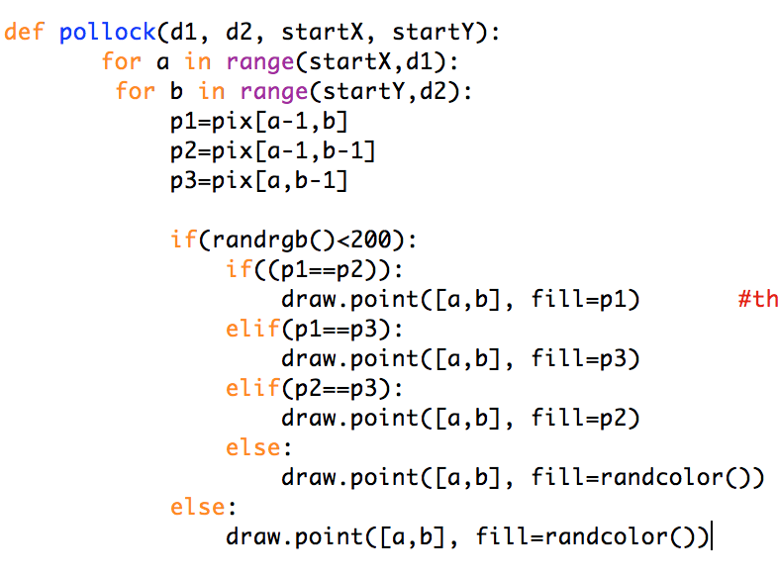
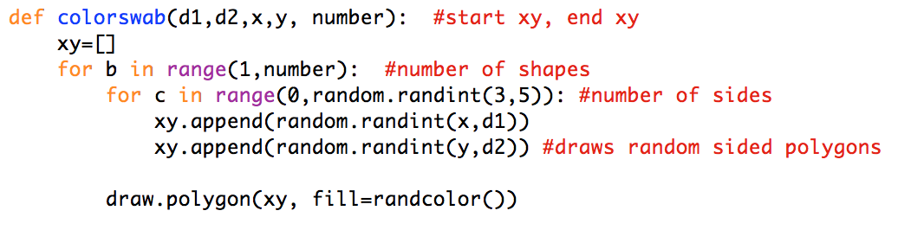
Building Pycasso
Python
Python Image Library
Random numbers (a lot)
Half you guys don’t even understand code why am I even putting the code here

Slide 6
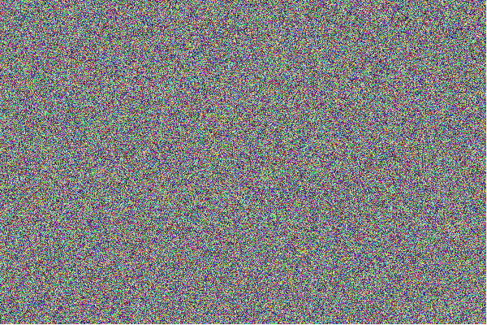
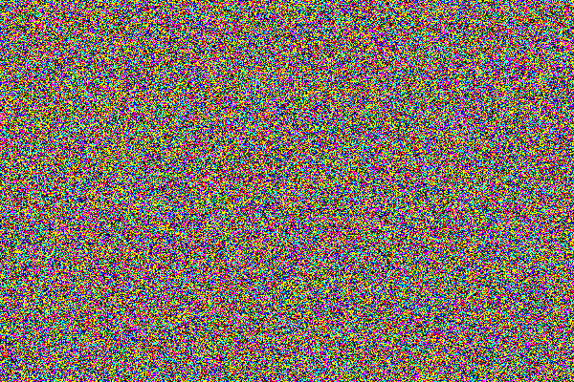
The Results
24,000 randomly colored pixels. (test2)
24,000 pixels of 7 preset colors. (test6)
Note: every photo with a (testXX) under it was generated with my own algorithm: pycasso.py

Slide 7
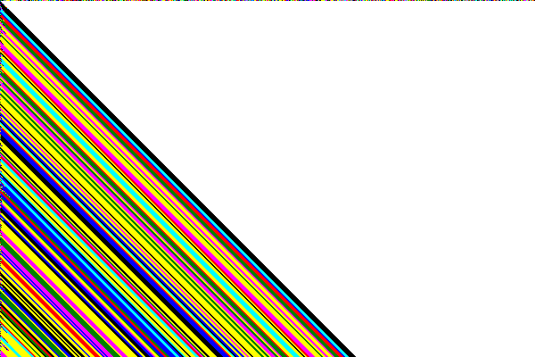
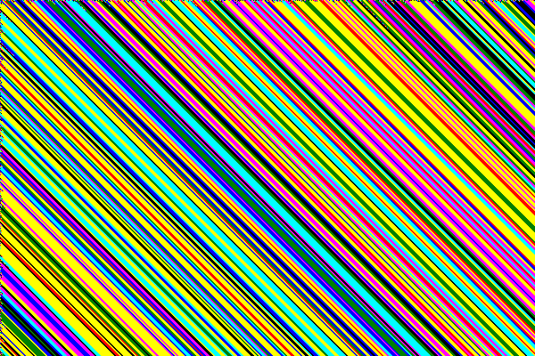
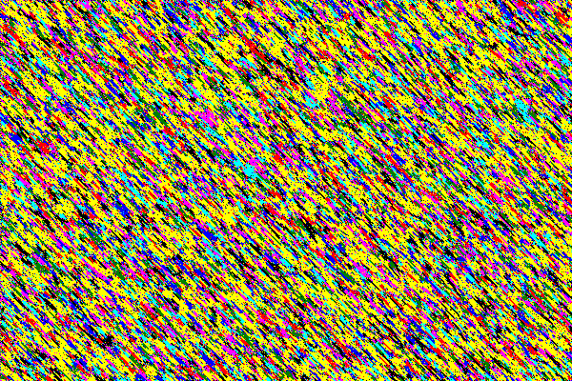
Results continued
Accidental error created this.
(test10)
Error fully implemented. (test18)
Threw random numbers in, got Jackson Pollock. (test23)

Slide 8
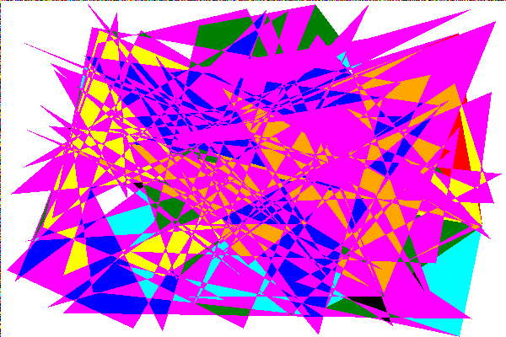
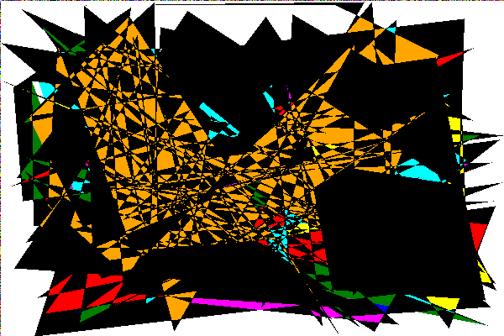
More results (or am I just showing off?)
Random numbers and shapes. (test29)
Opened an interdimensional portal. (test30)

Slide 9
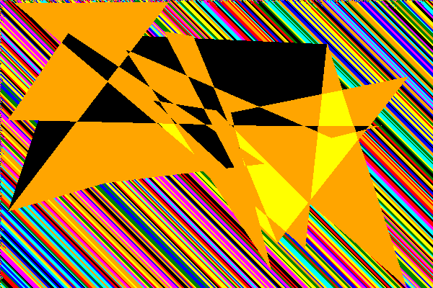
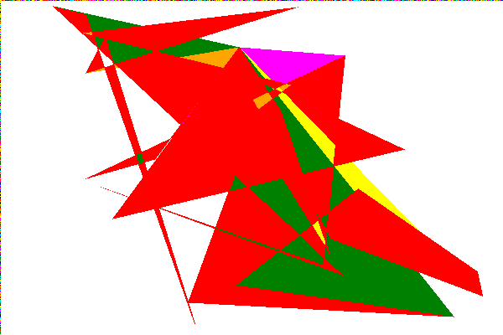
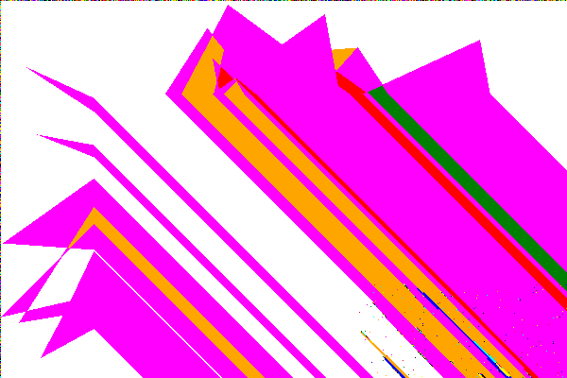
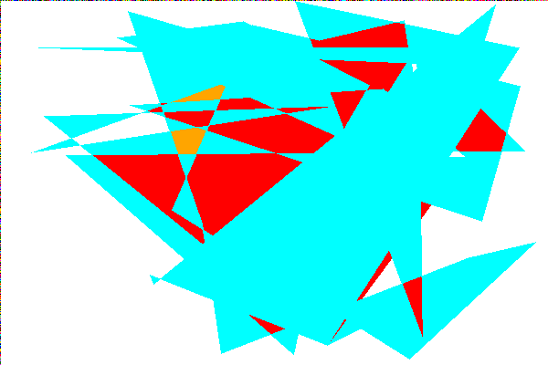
Results
Mixed stripes and shapes.
(test37+49)
Closed the portal.
(test34+41)

Slide 10
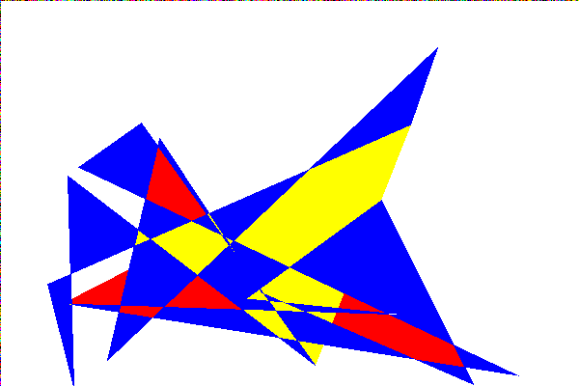
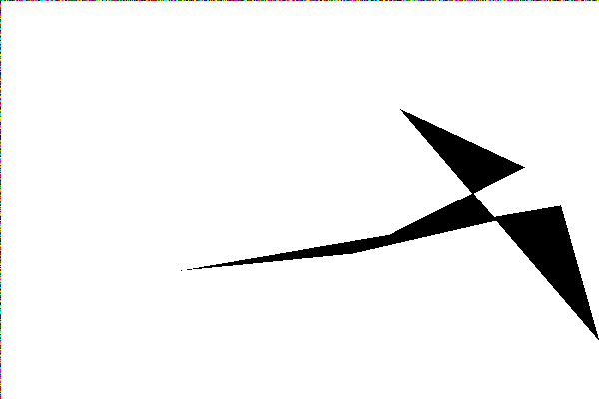
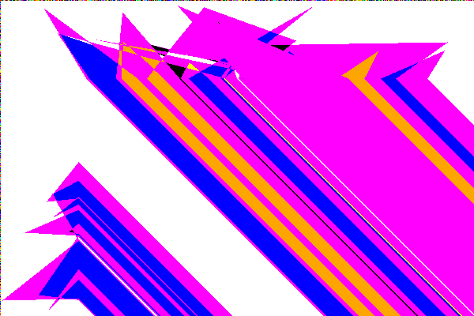
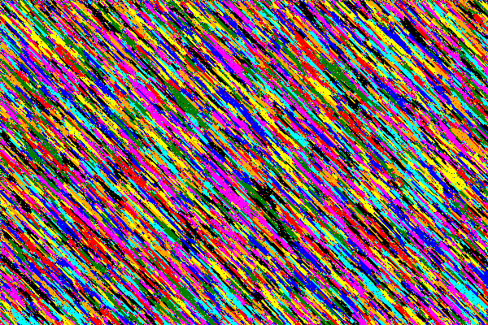
Best Results
4th dimension baby’s toy
(test121)
Looks like an abstract bird.
(test60)
Really good color spill.
(test43)
Jackson Pollock’s bio notes
(test25)

Slide 11
Beyond Pycasso
Artificial Intelligence
How they do it
Ethics: who gets credit?
Figure 4. Which one is human and which is AI? (2017). Artworks created by Creative Adversarial Networks (CAN) artificial intelligence. [Collage of photographs] Retrieved from https://news.artnet.com/art-world/rutgers-artificial-intelligence-art-1019066

Slide 12
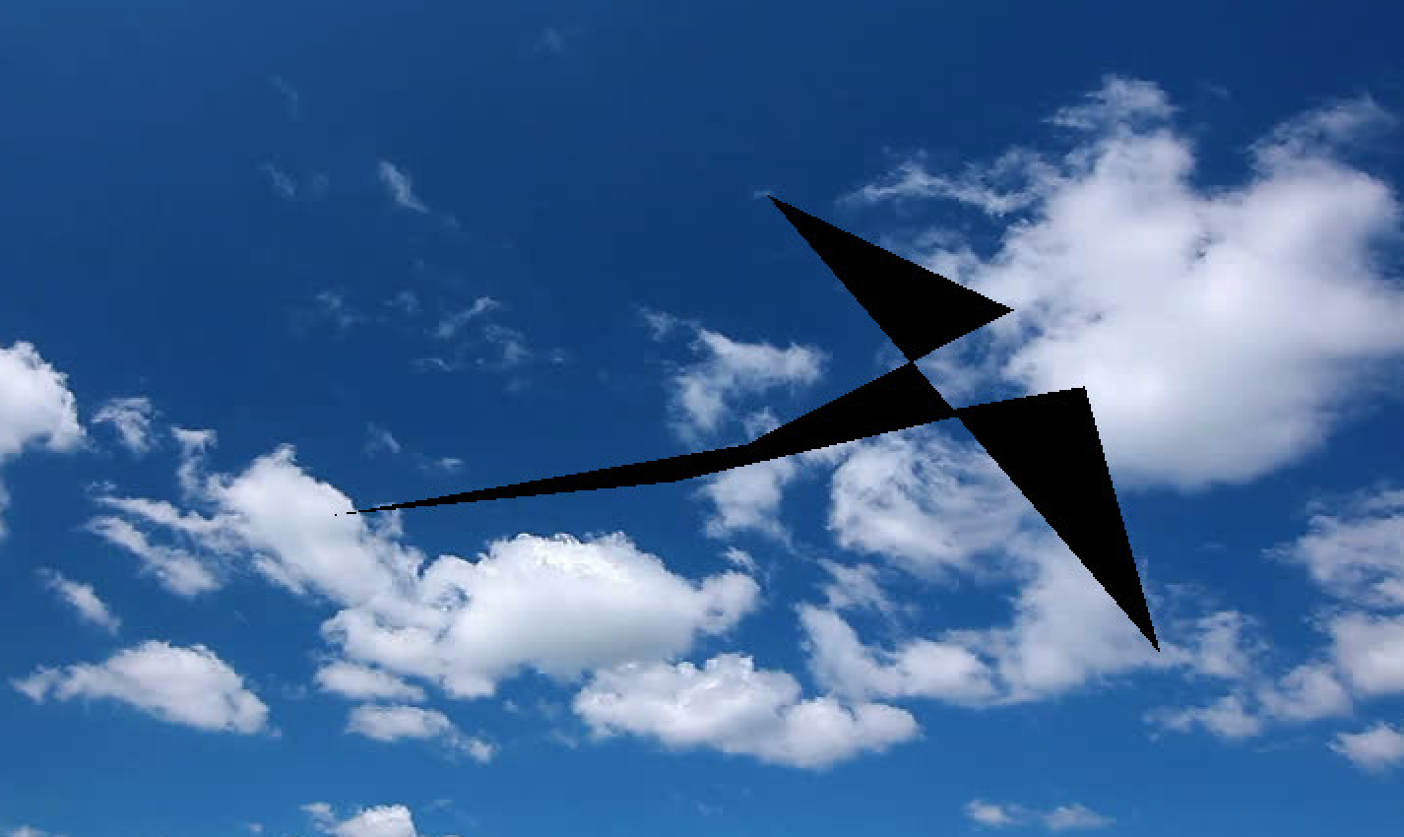
Thanks for Listening!
Feed this bird, tuppence a bag.

Slide 13
References
Cascone, S. (2017, July 11). AI-generated art now looks more convincingly human than work at Art Basel, study says. Retrieved March 8, 2018, from https://news.artnet.com/art-world/rutgers-artificial-intelligence-art-1019066
CruxCreative. (2012, February 23). RGB vs CMYK: When to use which and why. Retrieved March 8, 2018, from https://cruxcreative.com/rgb-vs-cmyk-when-to-use-which-and-why/
Editors of Encyclopaedia Britannica. (2017, November 1). Pixel. Retrieved from Encyclopaedia Britannica database.
Makridakis, S. (2017). The forthcoming Artificial Intelligence (AI) revolution: Its impact on society and firms. Futures, 90, 46-60. https://doi.org/10.1016/j.futures.2017.03.006
Thejokalyani, N., & Dhoble, S. (2014). Novel approaches for energy efficient solid state lighting by RGB organic light emitting diodes – A review. Renewable and Sustainable Energy Reviews, 23, 448-467. https://doi.org/10.1016/j.rser.2014.01.013

